Slide 1
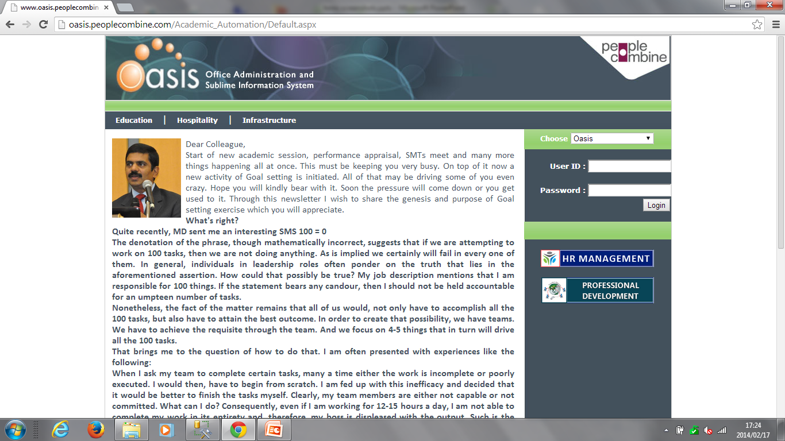
Click on this

Slide 2
“For Online resume entry” Click on this

Slide 3
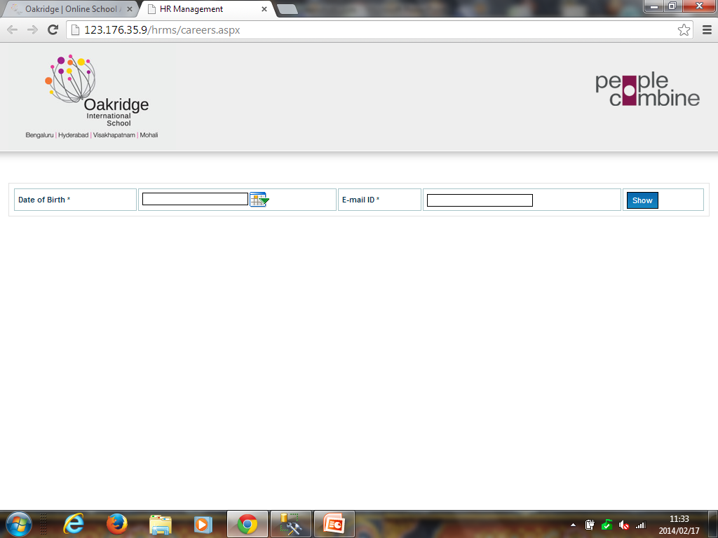
Enter the above details and click on “show”

Slide 4
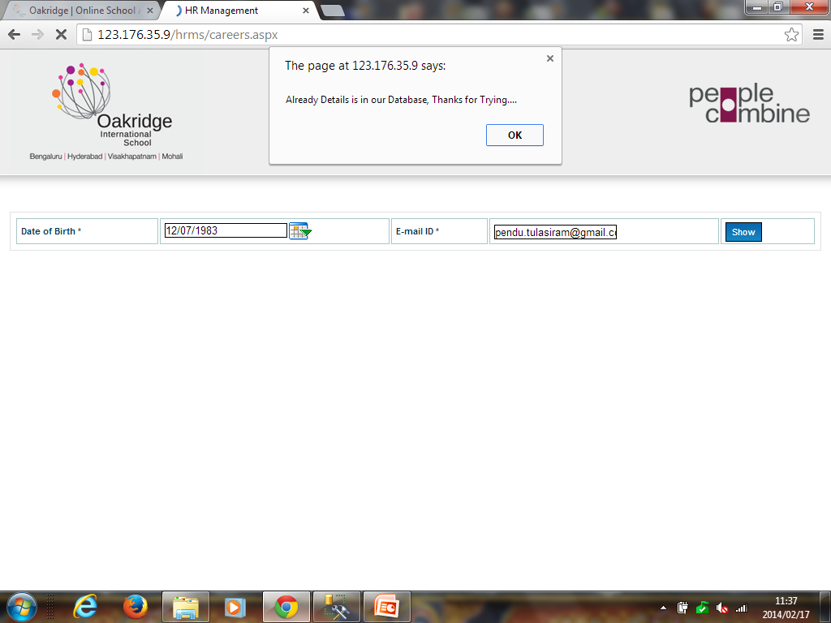
If the details already exist the above message is displayed

Slide 5
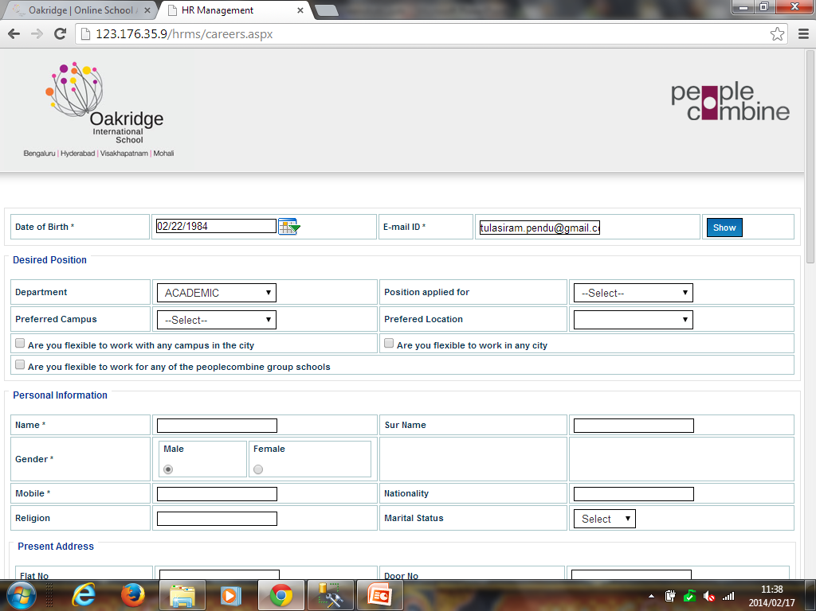

Slide 6
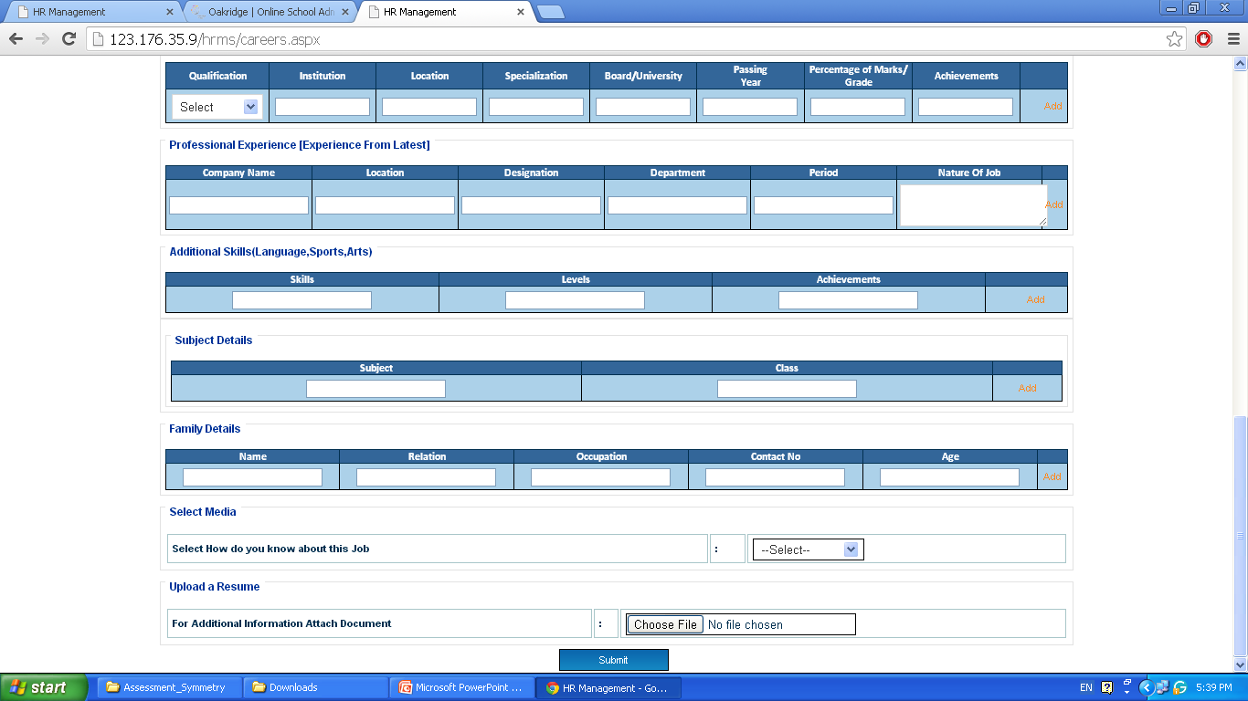
Enter all the details and click on submit button

Slide 7
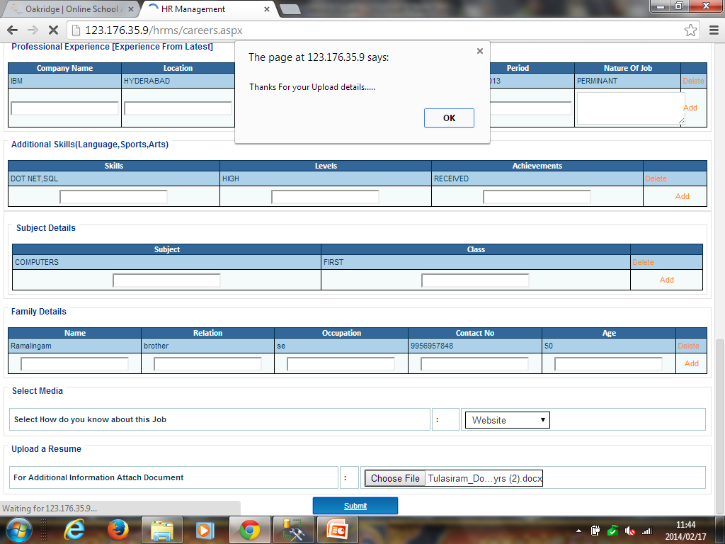
Click on “ok”

Slide 8
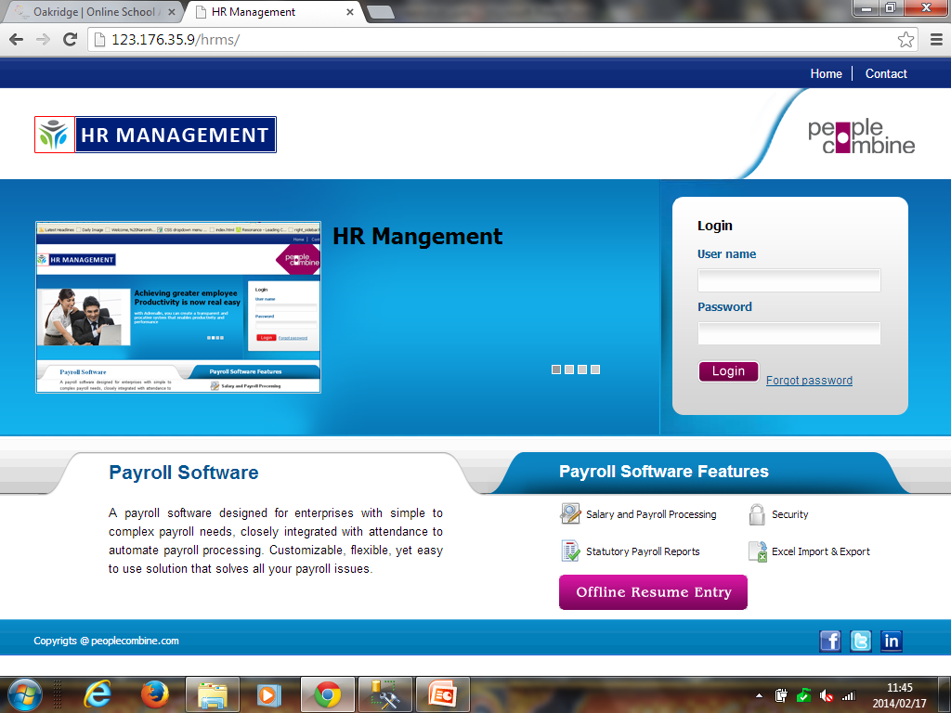
Data entry operators need to enter the Offline resume
For “Offline resume Entry” Click on this
Notes:
Offline Resume Entry Slide

Slide 9
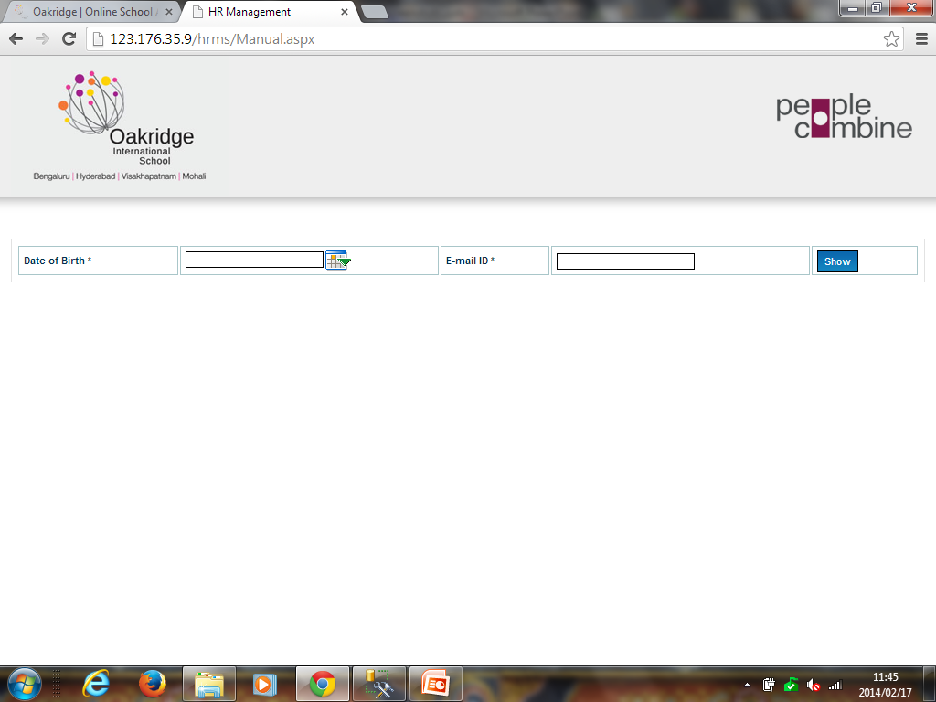
Enter the above details and click on “show”
Notes:
Offline Resume Entry Slide

Slide 10
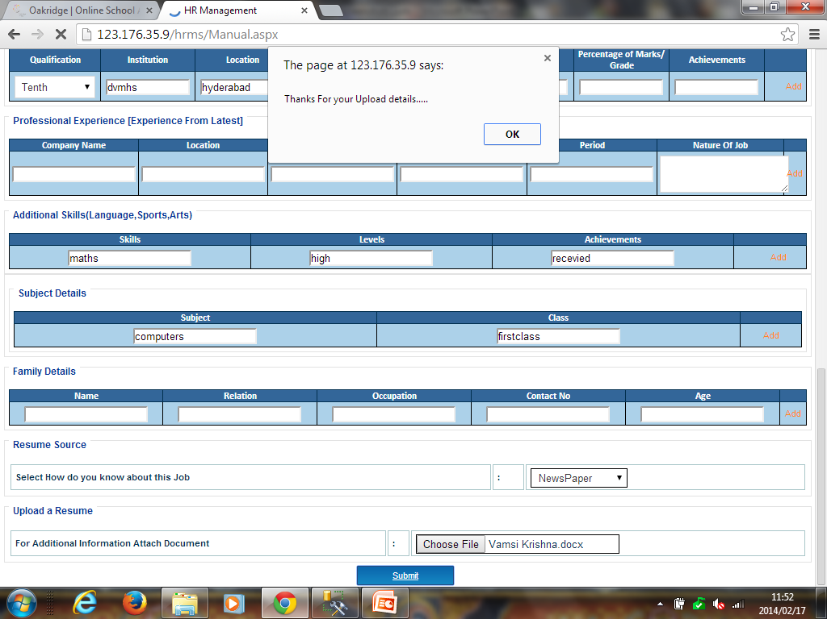
Enter all the details and click on “submit” button

Slide 11
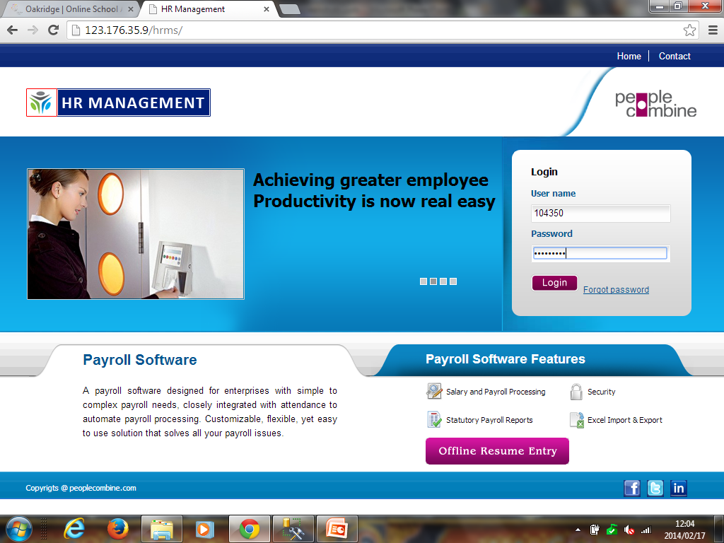
Enter the login details and click on “Login” button

Slide 12
To fill “Partial Resume” click on this

Slide 13
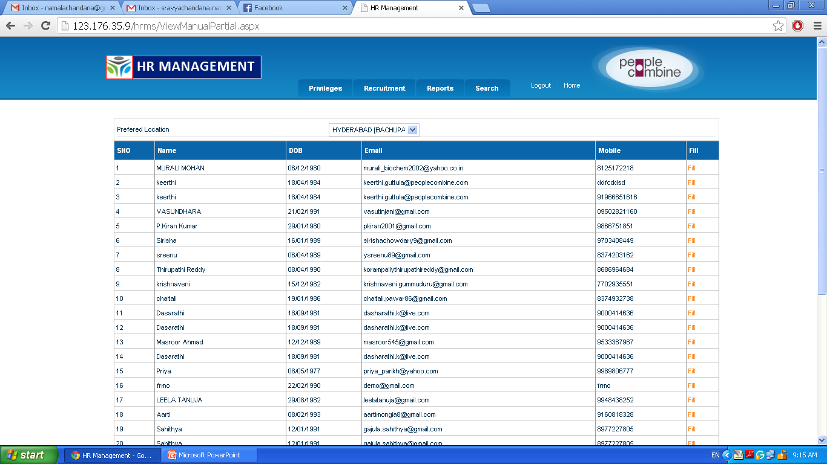
Only HR can enter the partial resume details of particular candidate
Click on “Fill”
Notes:
If all the details are not entered by offline resume, then click on “fill” and enter all the details.

Slide 14
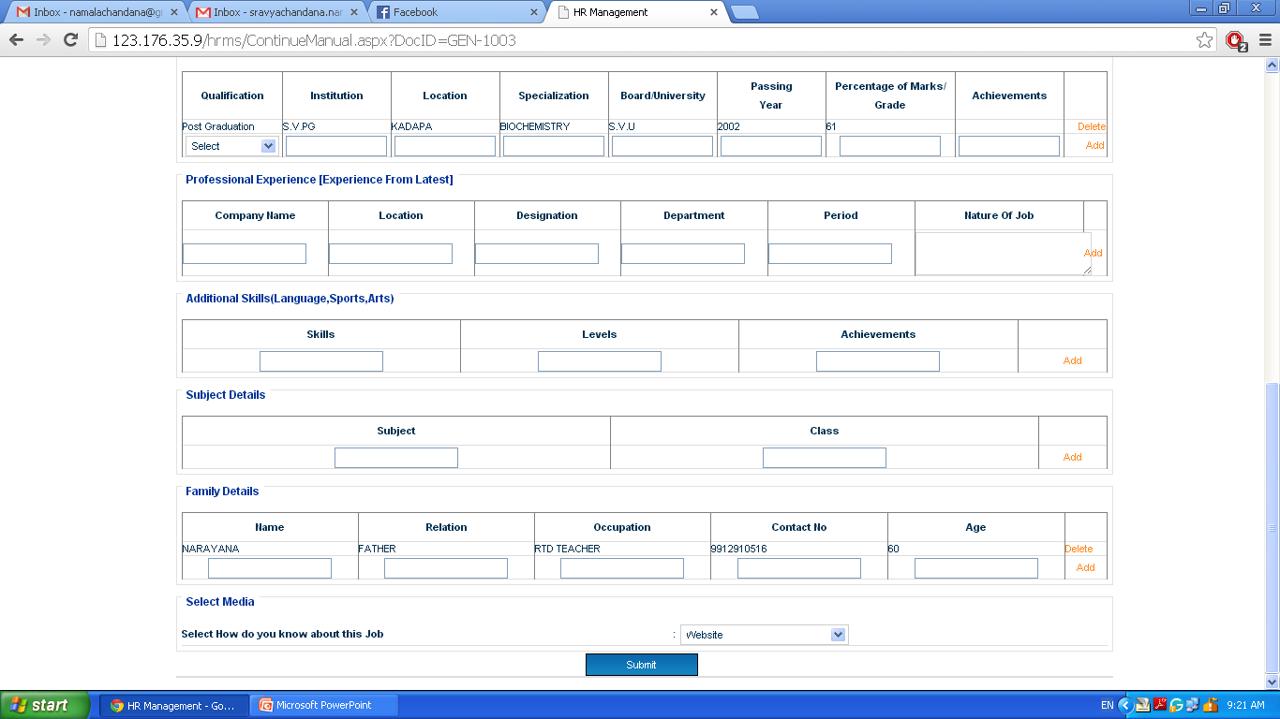
Enter the partial data in the empty fields and submit

Slide 15
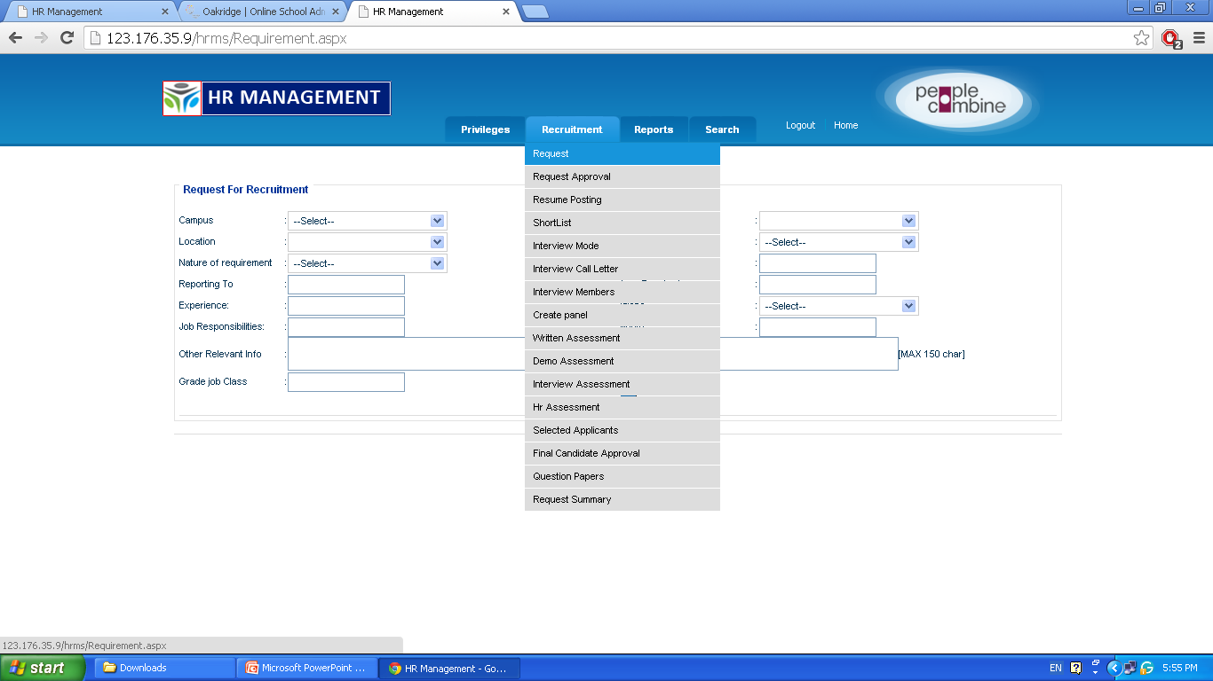
Click on ”Request”

Slide 16
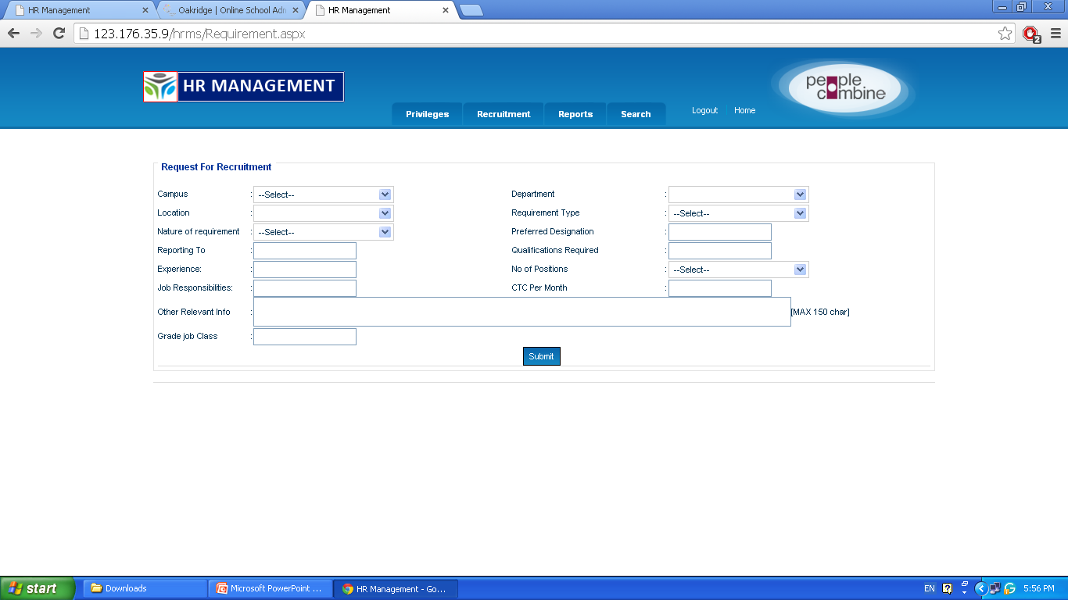
Enter all the details and click on “Submit”

Slide 17
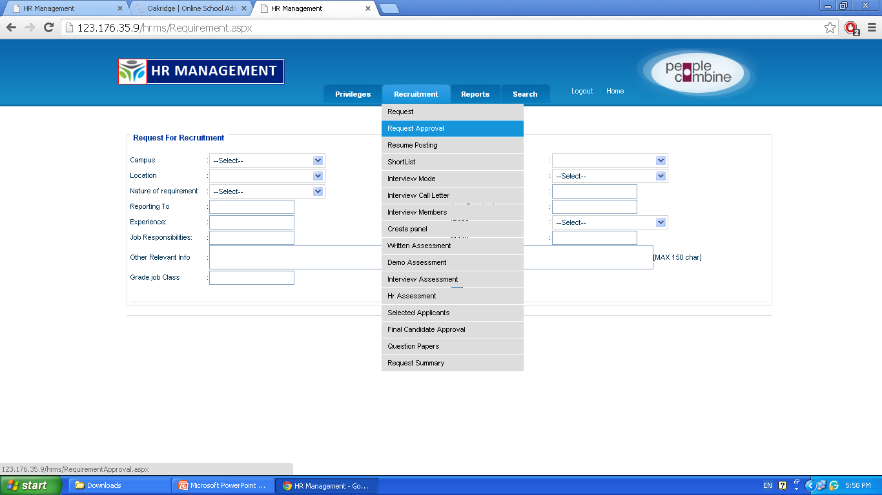
Click on “Request Approval”

Slide 18
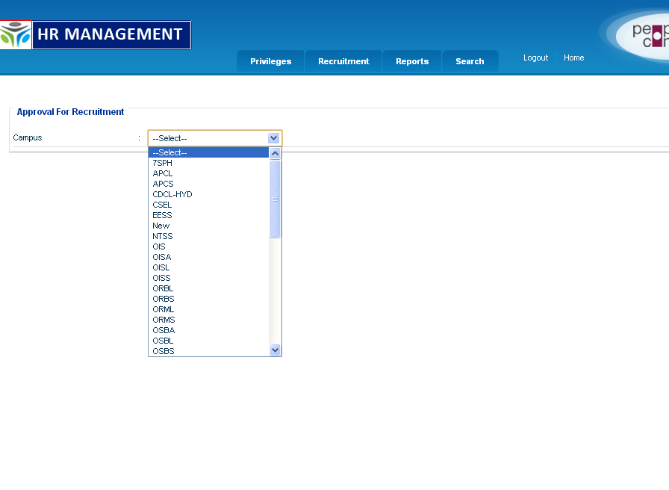
Select the campus

Slide 19
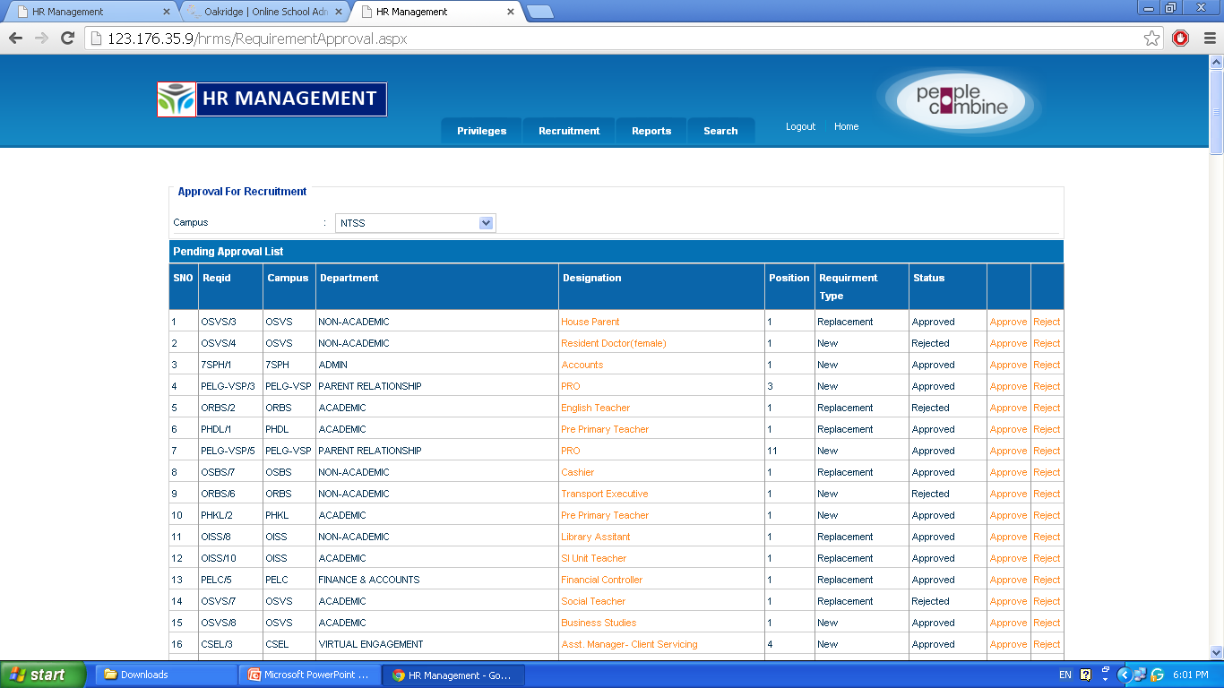
Click on “Approve”

Slide 20
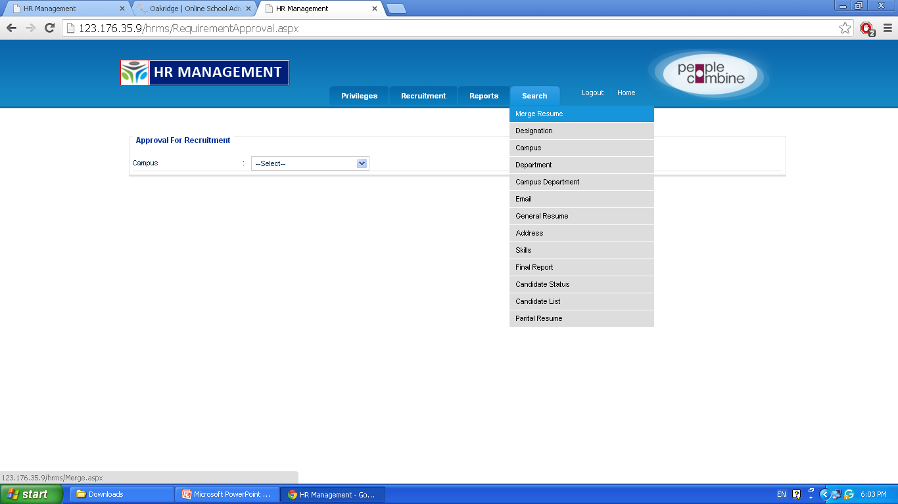
Click on “Merge Resume”

Slide 21
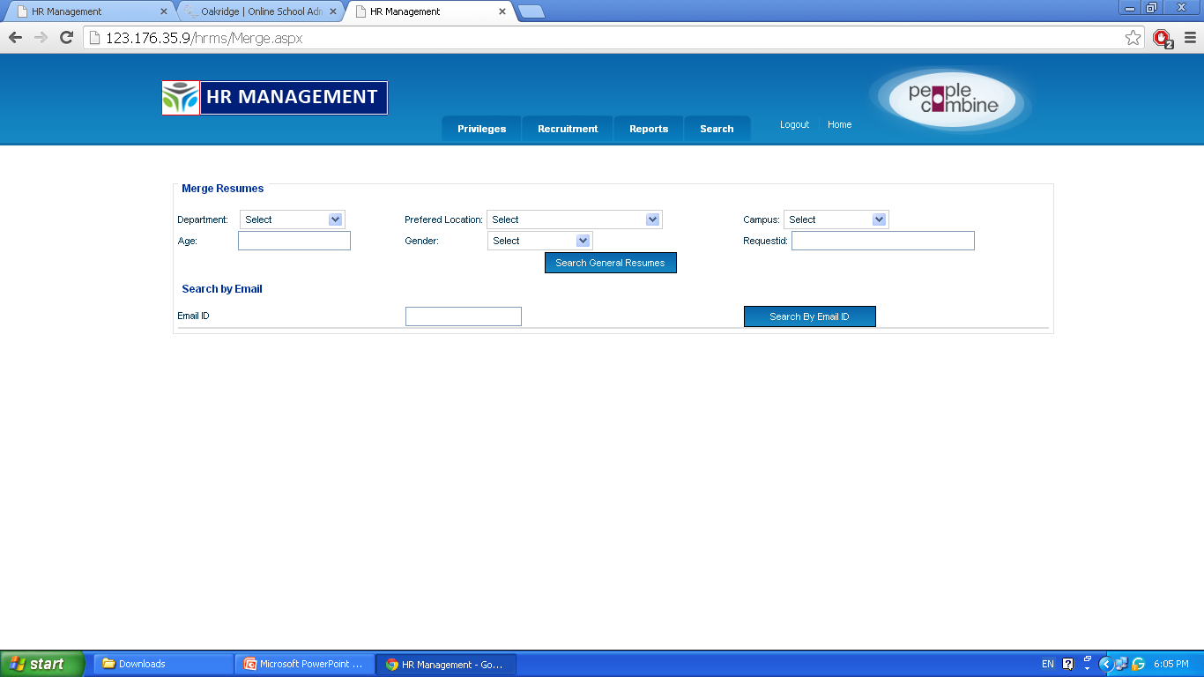
Search the Resume for particular request
Enter details and click on this

Slide 22
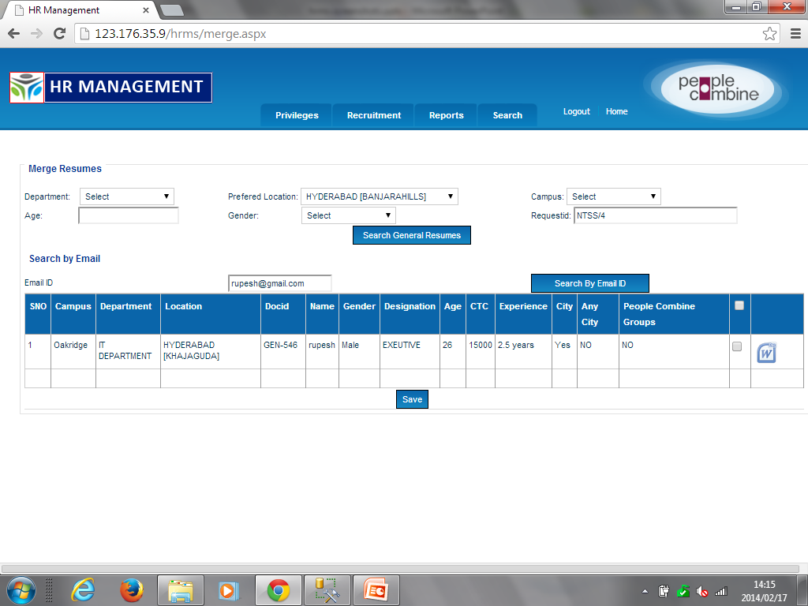
1. Select the checkbox
2. Click on “save“ button

Slide 23
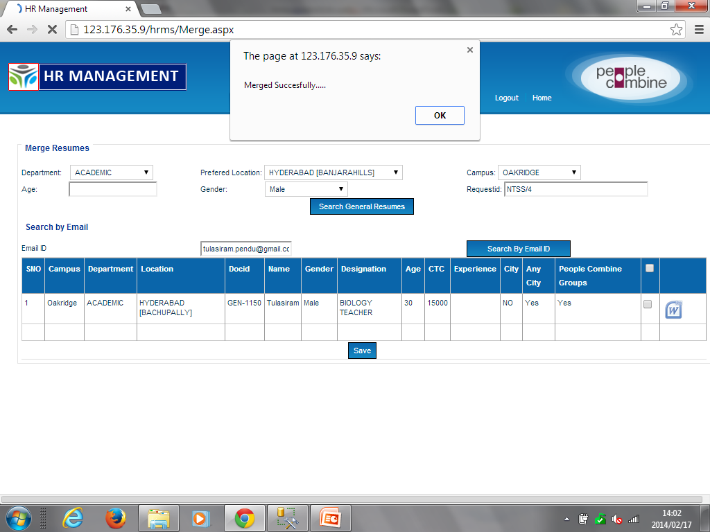
Click ok

Slide 24
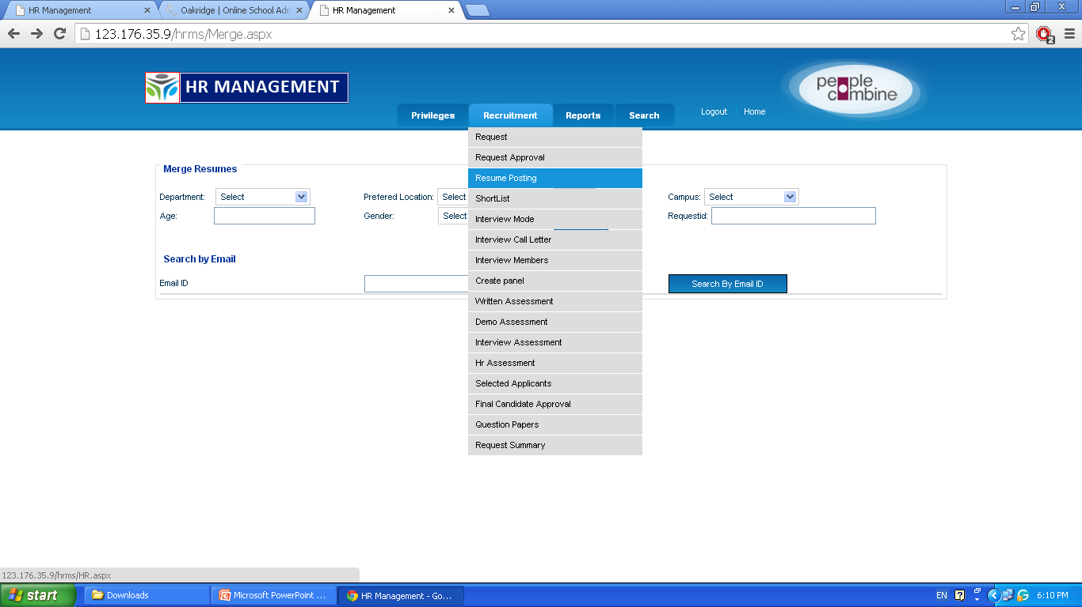
Click on “Resume Posting”

Slide 25
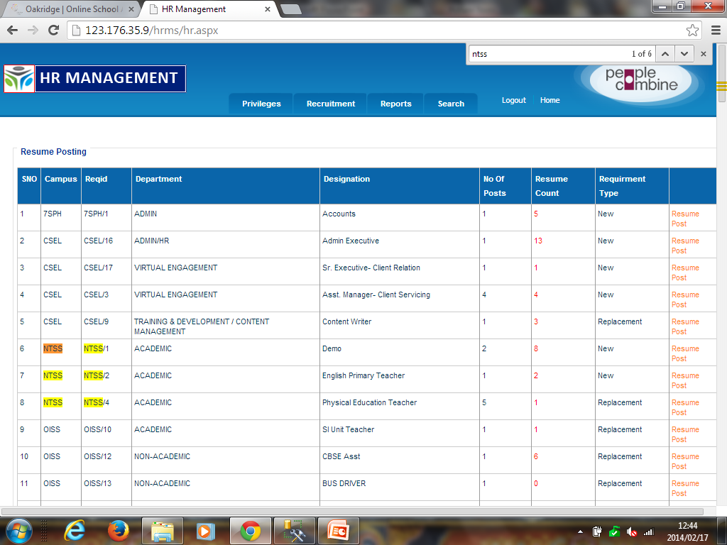
Click on “Resume Post” to upload resume for particular request
Verify the resume count

Slide 26
Click on “Shortlist”

Slide 27
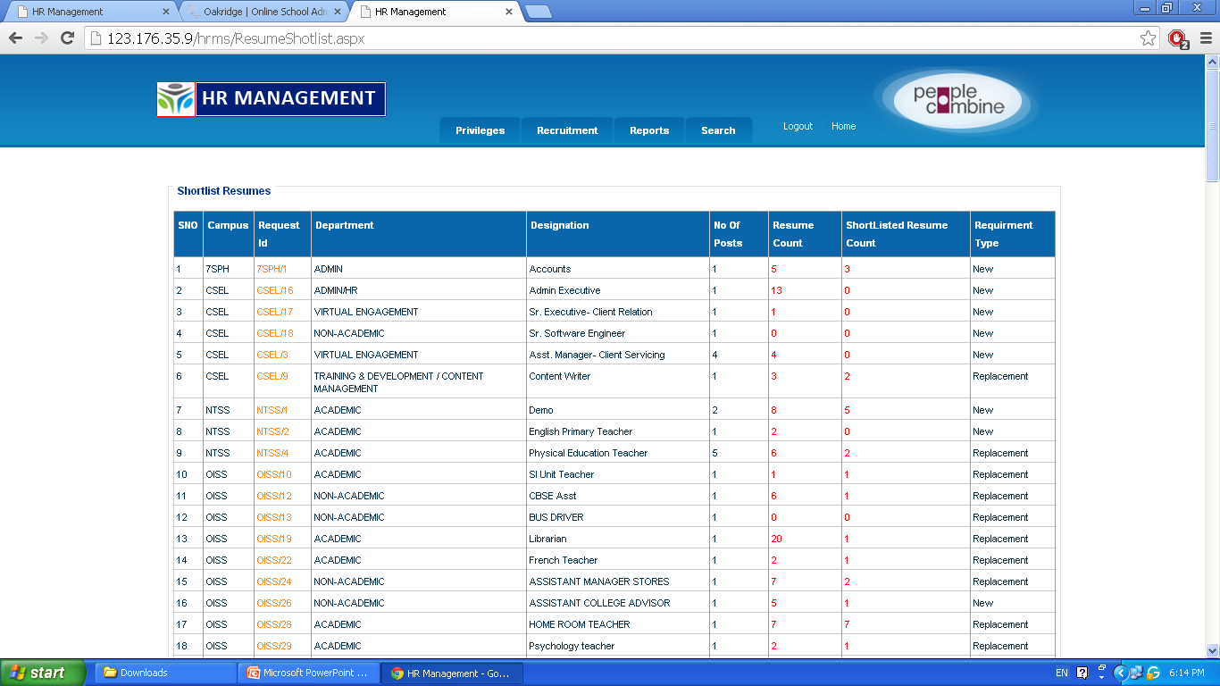
Click on “Request Id”

Slide 28
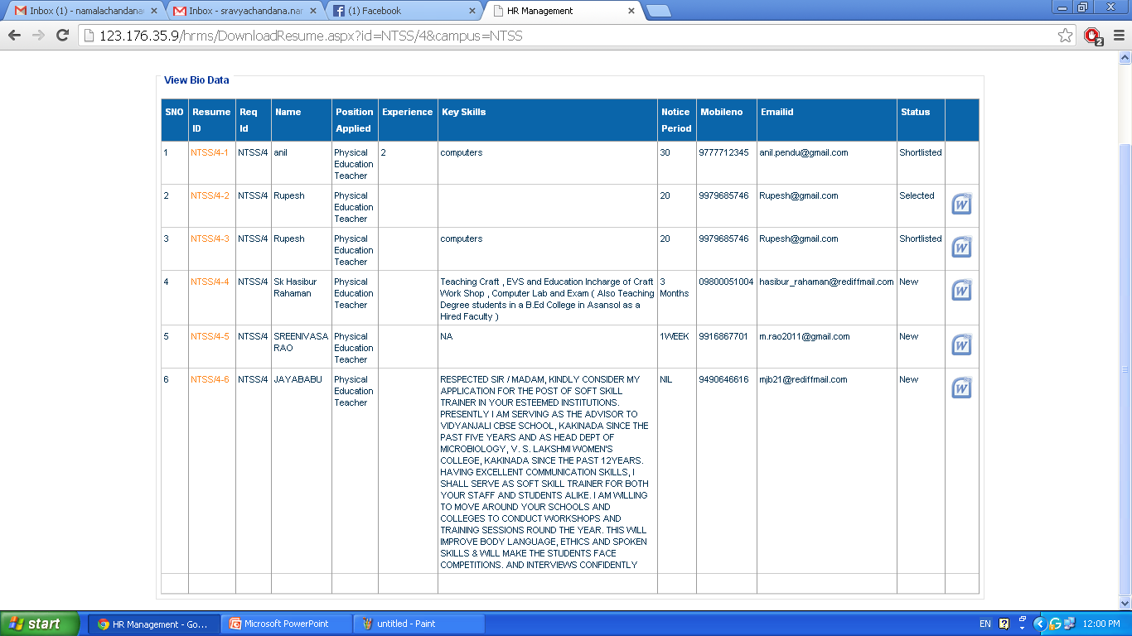
Click here for “Shortlisted Resumes”

Slide 29
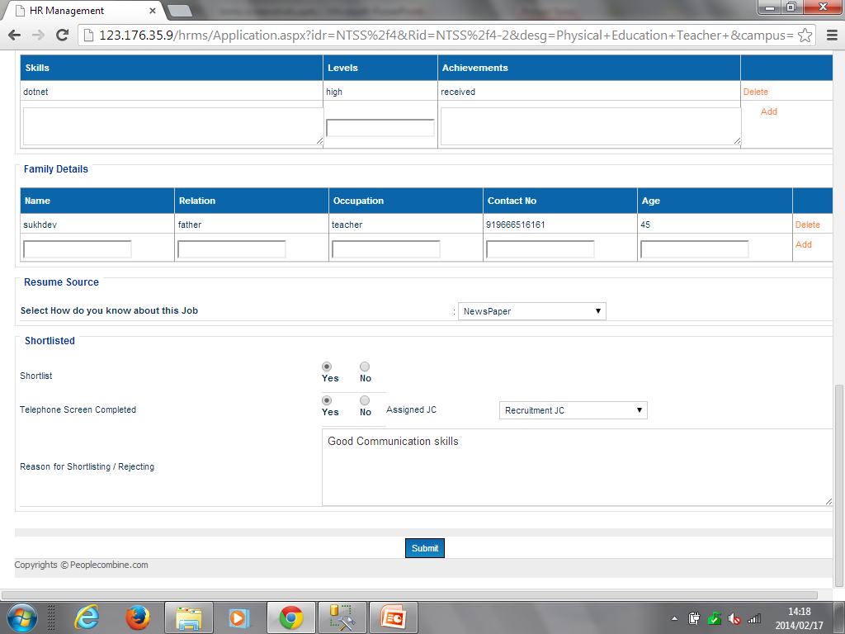
Select Assigned JC and enter the reason
Select the shortlist and click on “Submit” button

Slide 30
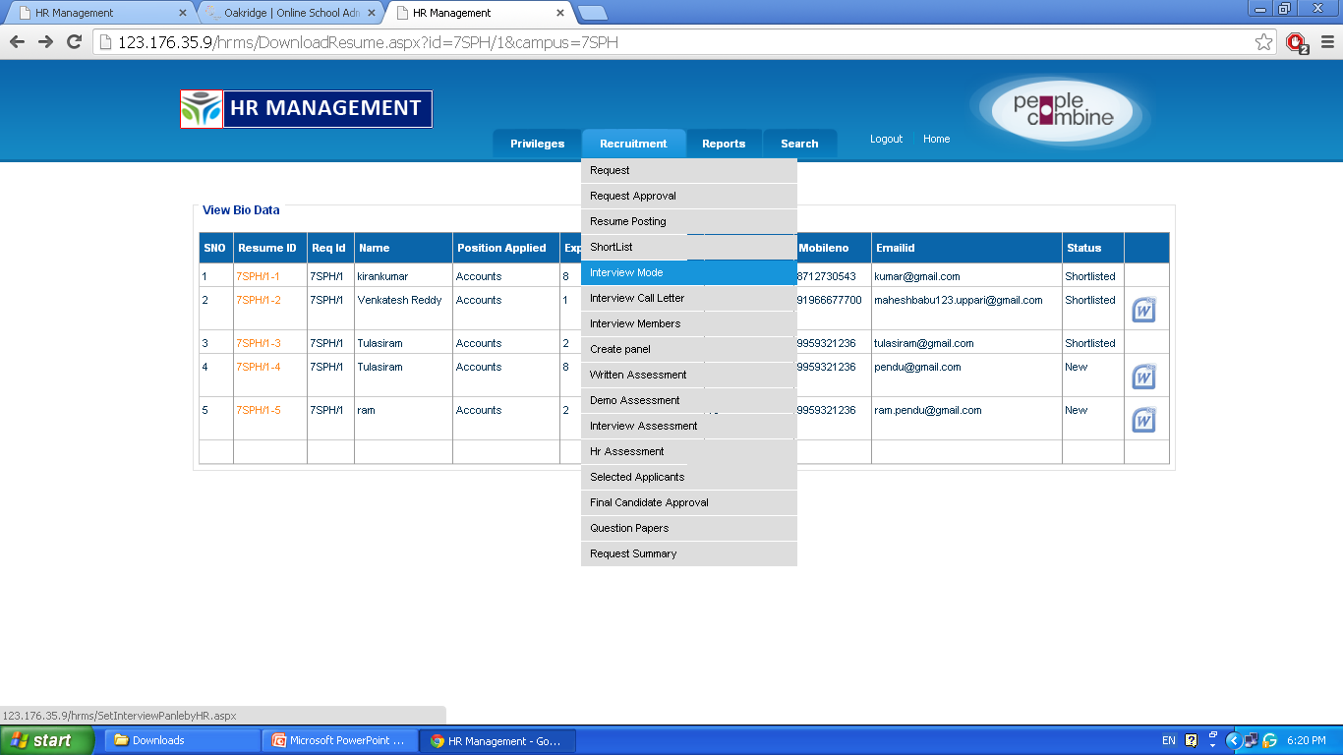
Click on “Interview mode”

Slide 31
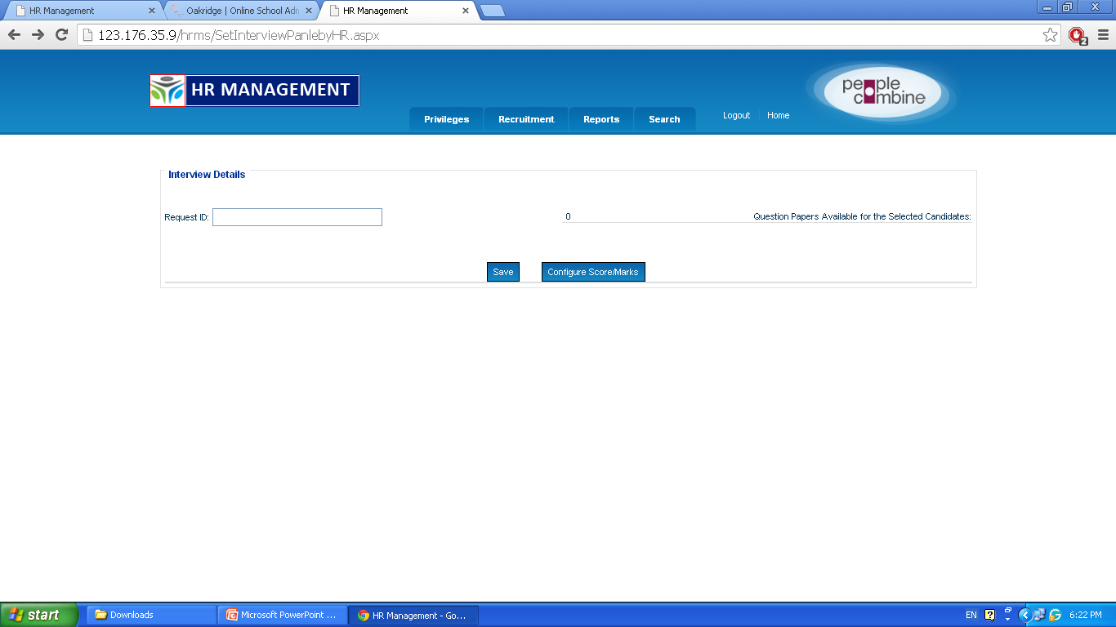
Enter the “Request ID”

Slide 32
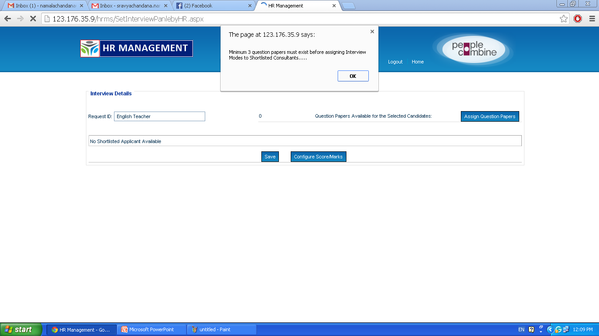
After selecting the Request ID the above screen is displayed

Slide 33
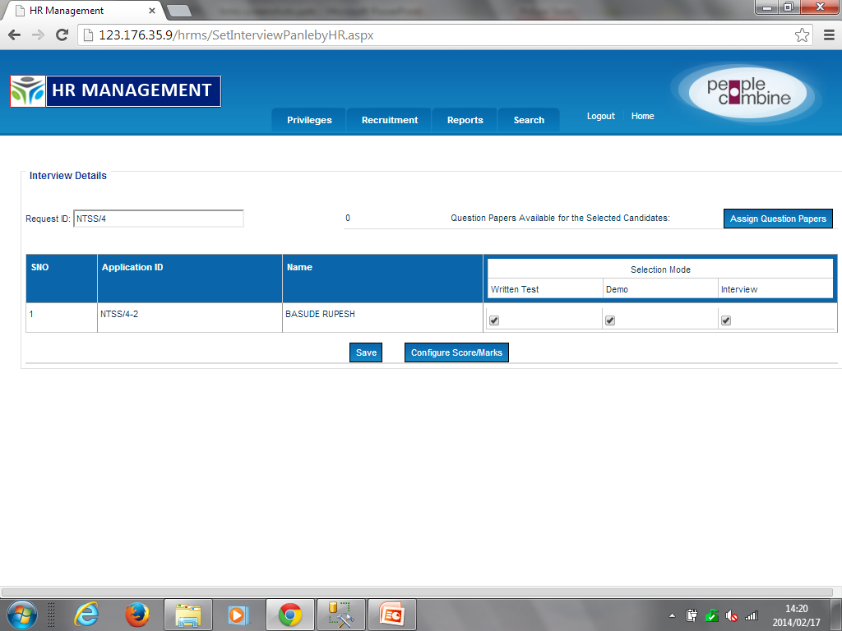
IF Request ID has Written Test, then assign Question paper. Click here
In selection mode Written test and Demo are optional.
Interview is mandatory
Notes:
Select the “Selection Mode”

Slide 34
Click on “save”. It automatically redirects to “Configure Score marks”

Slide 35
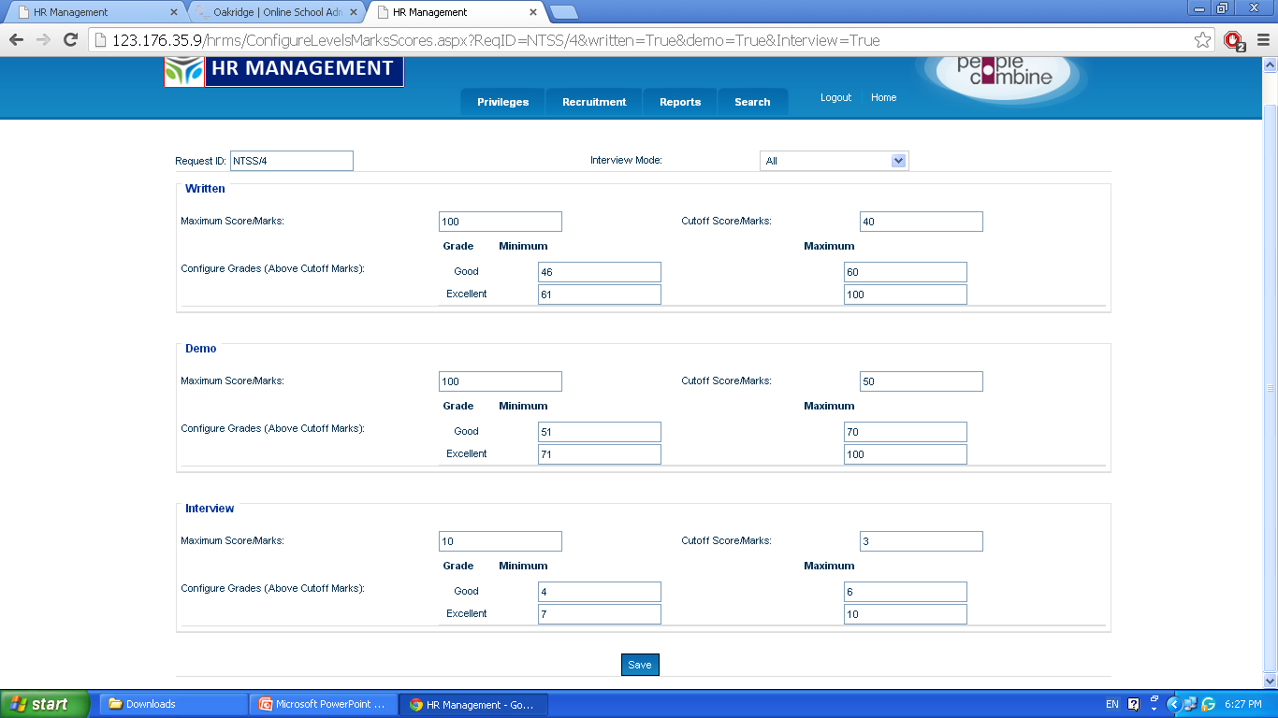
Enter the configure score marks and click on ”save” button
Notes:
Enter the marks into Written, Demo & Interview

Slide 36
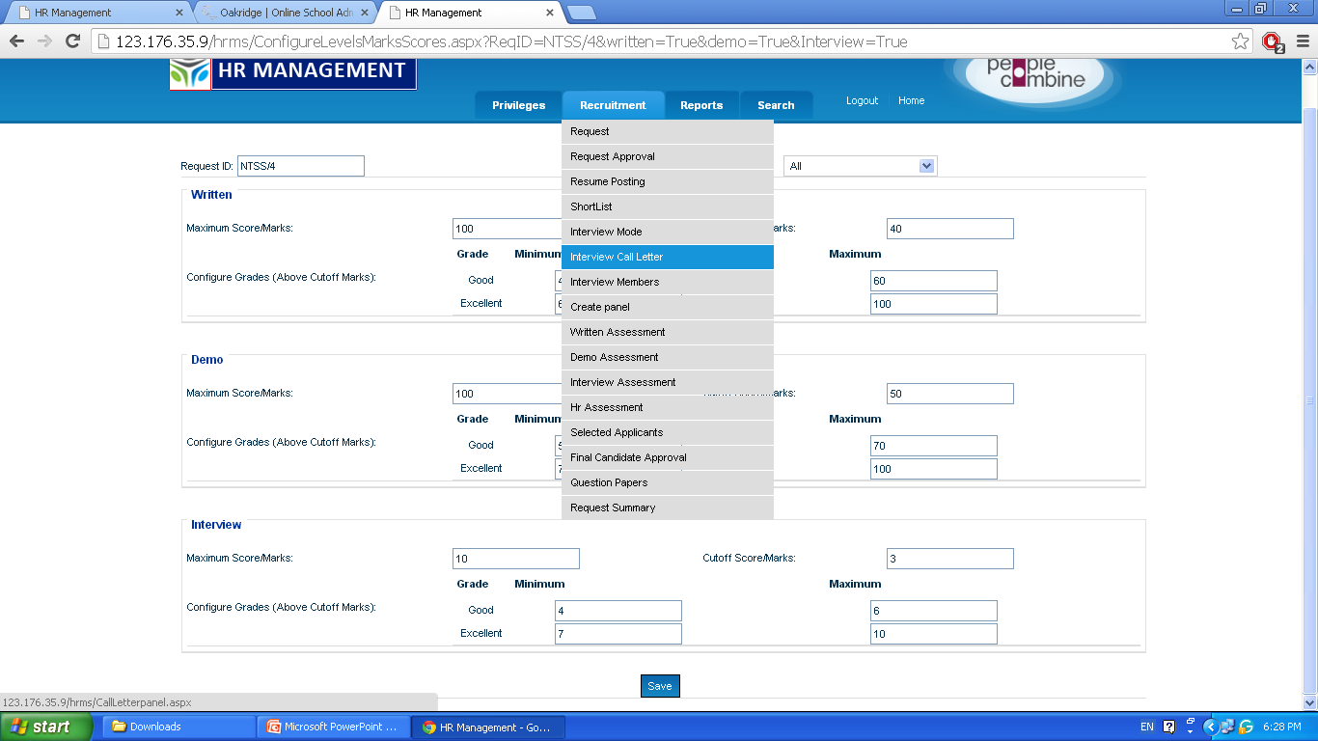
Click on “Interview Call Letter”
Notes:
On selecting the interview Call Letter. The call letter is displayed which is to be sent to that particular selected candidate

Slide 37
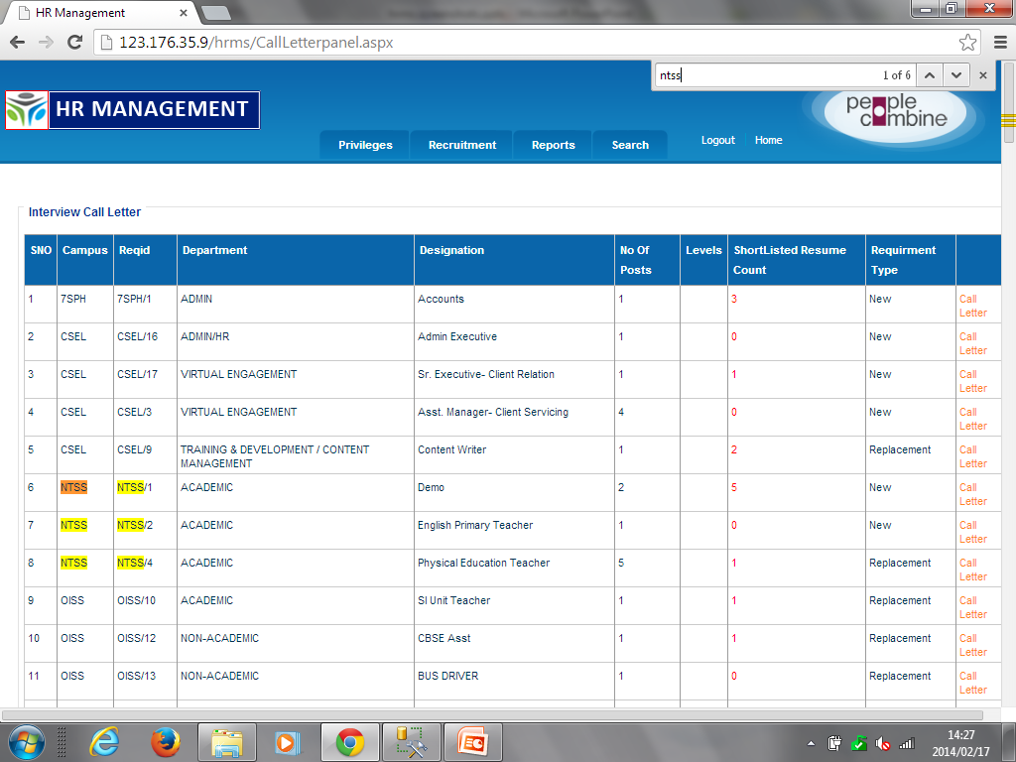
Click on “Call Letter”

Slide 38
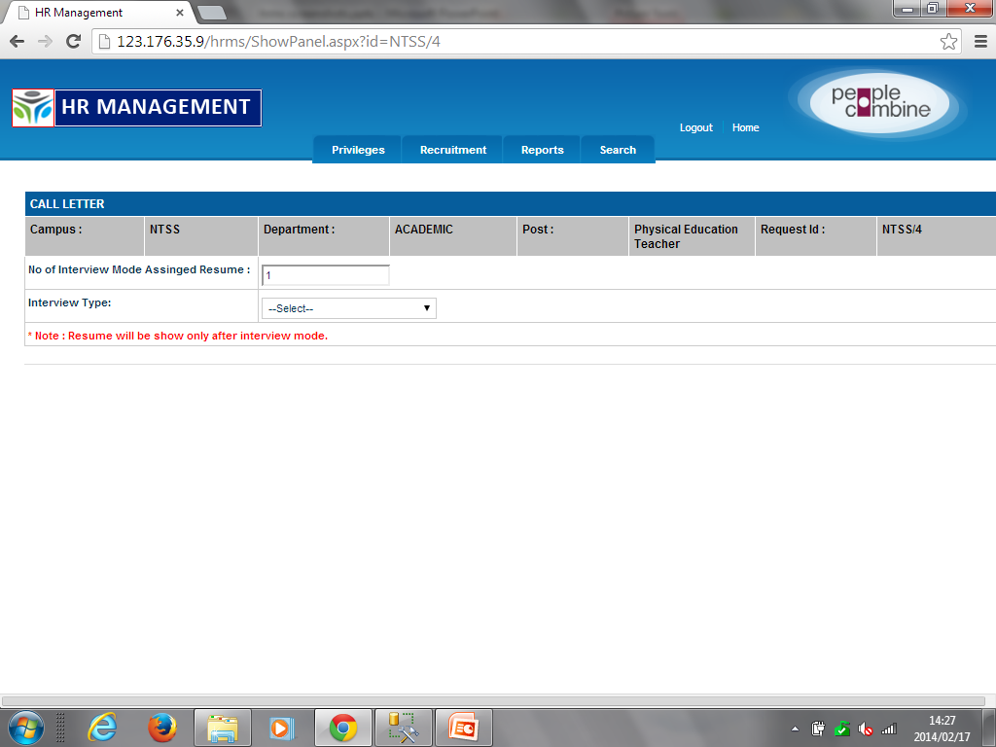
Select “Interview Type”

Slide 39
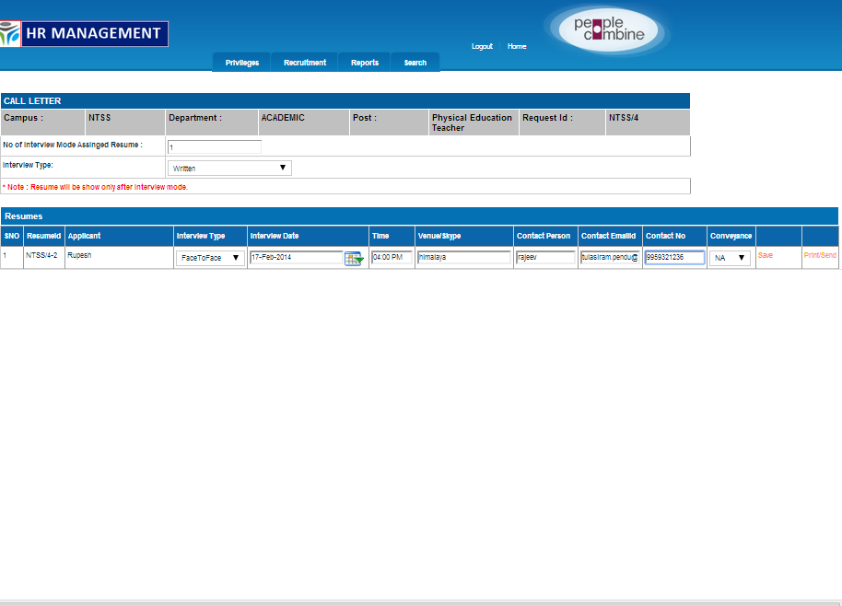
1. Enter the venue details Click on “save ”button.
All fields are mandatory
2. Click on Print/ send to print/send mail

Slide 40
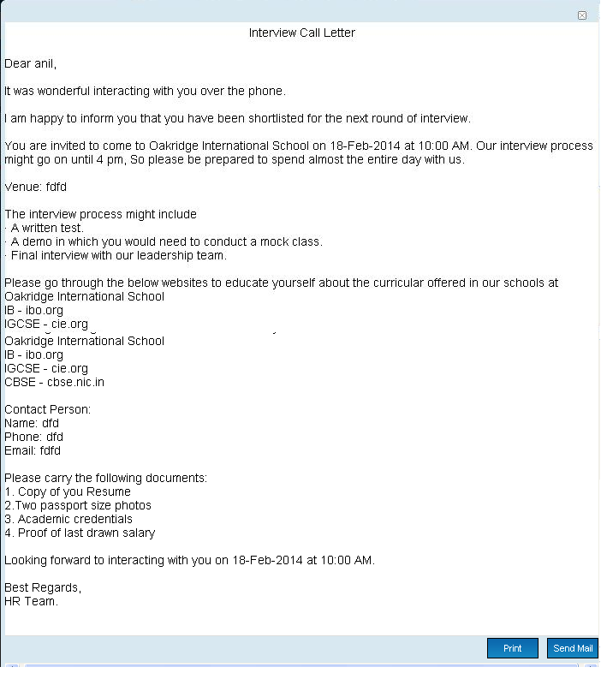
Please check and send the call letter

Slide 41
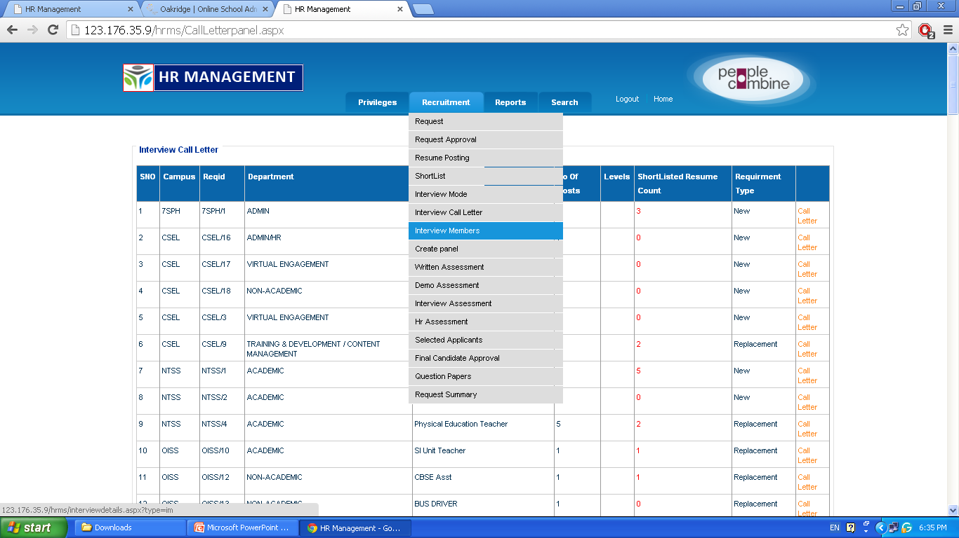
Click on “Interview Members”

Slide 42
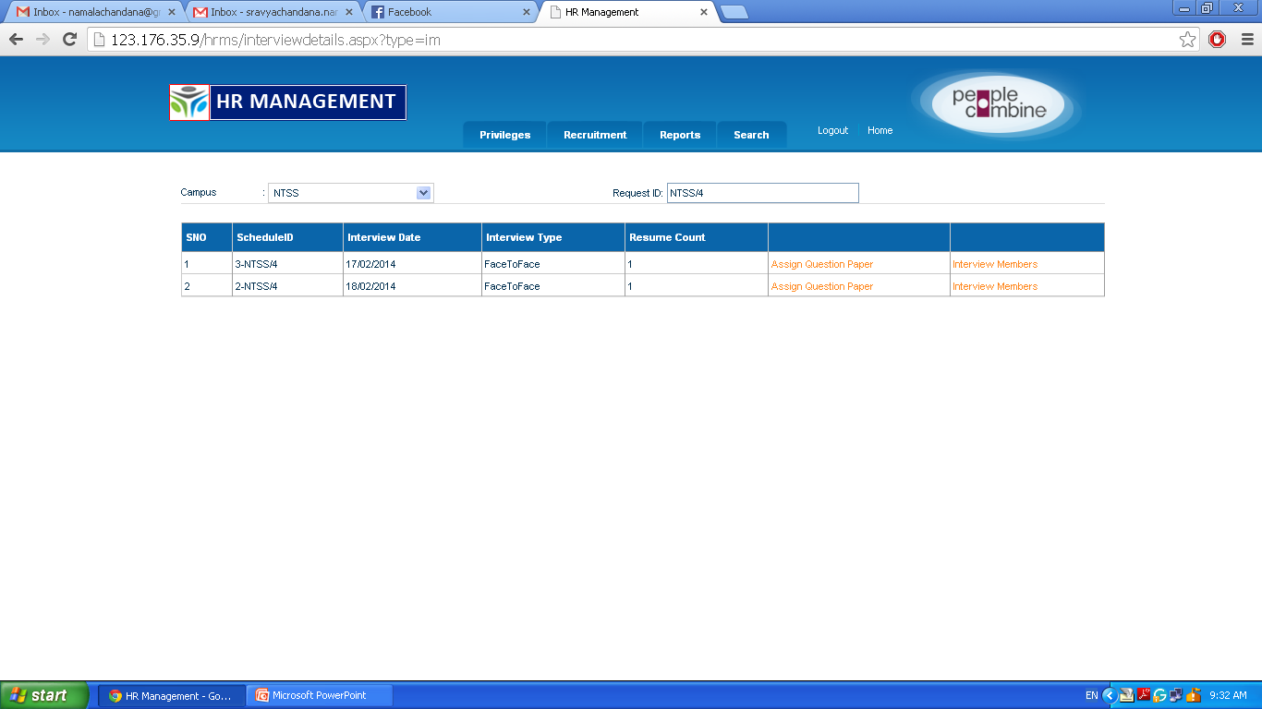
To assign “Interview members” click here

Slide 43
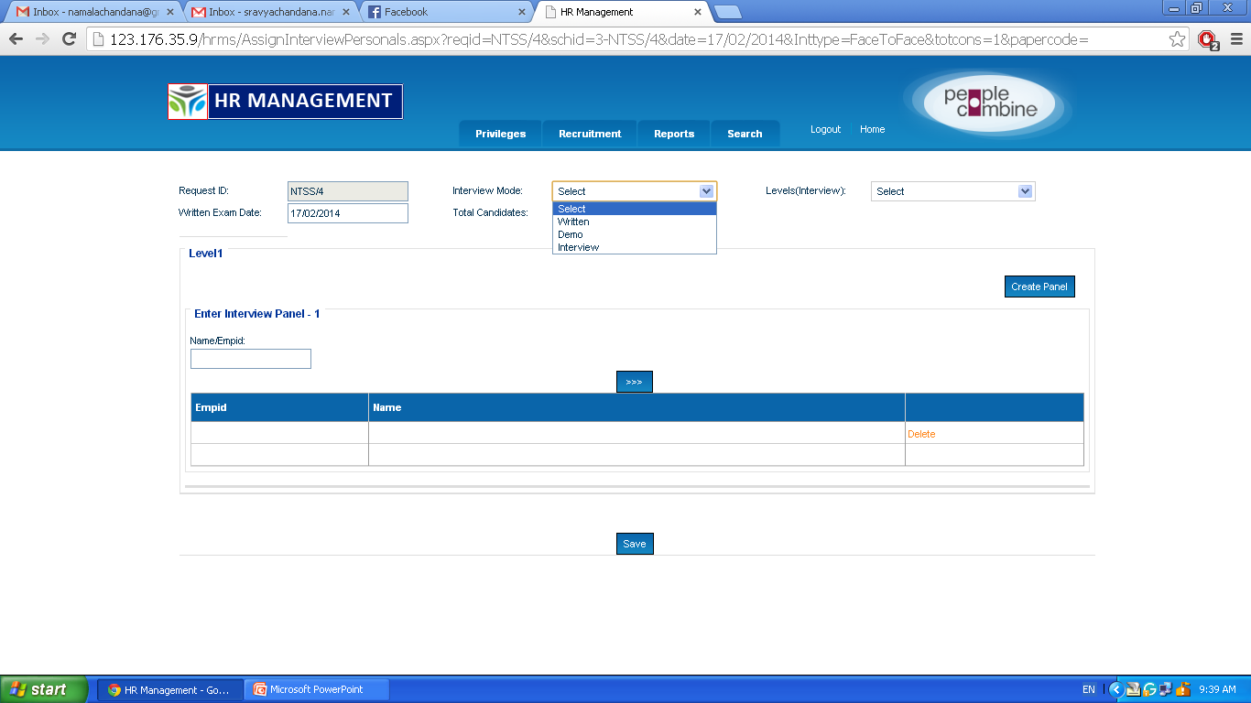
Select the Interview Mode
It is mandatory to create Panel for All interview modes

Slide 44
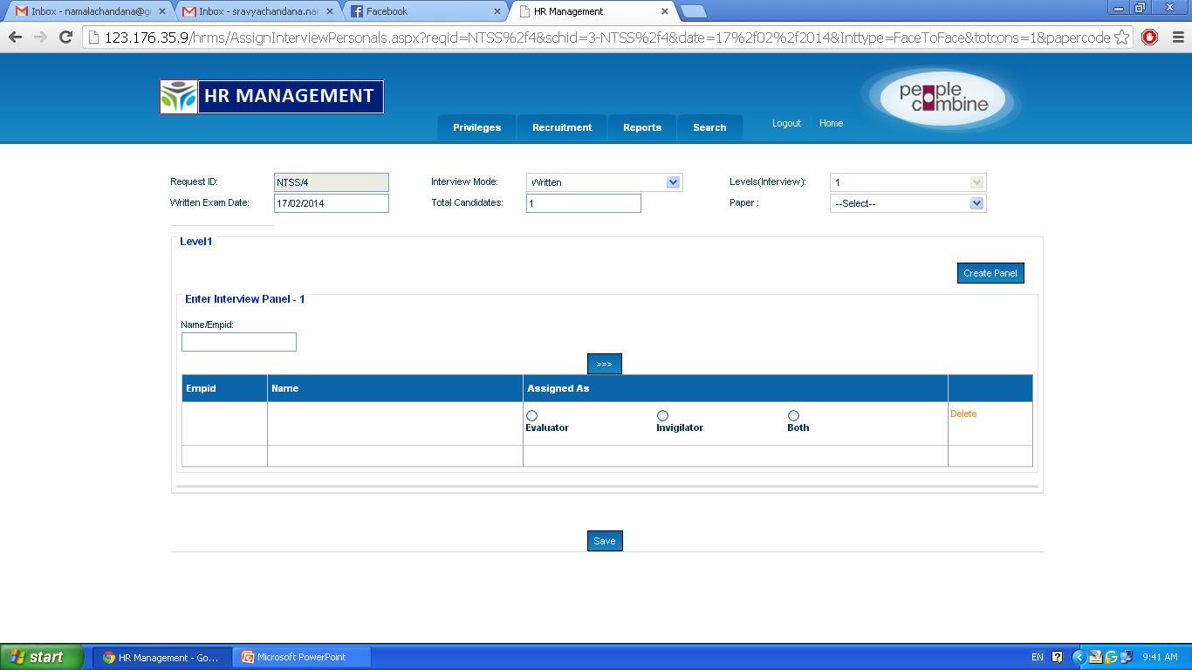
Enter the Name/Empid

Slide 45
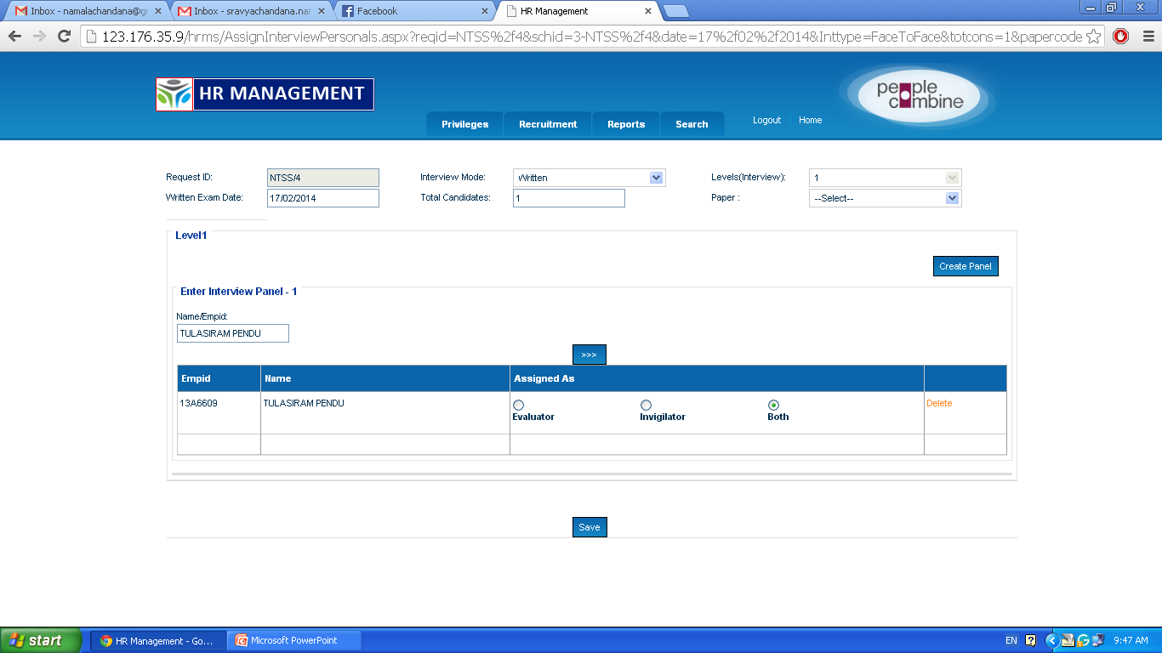
Assign the roles
And click on “save”
Notes:
The details of employee are displayed.

Slide 46
Click on “Create Panel”

Slide 47
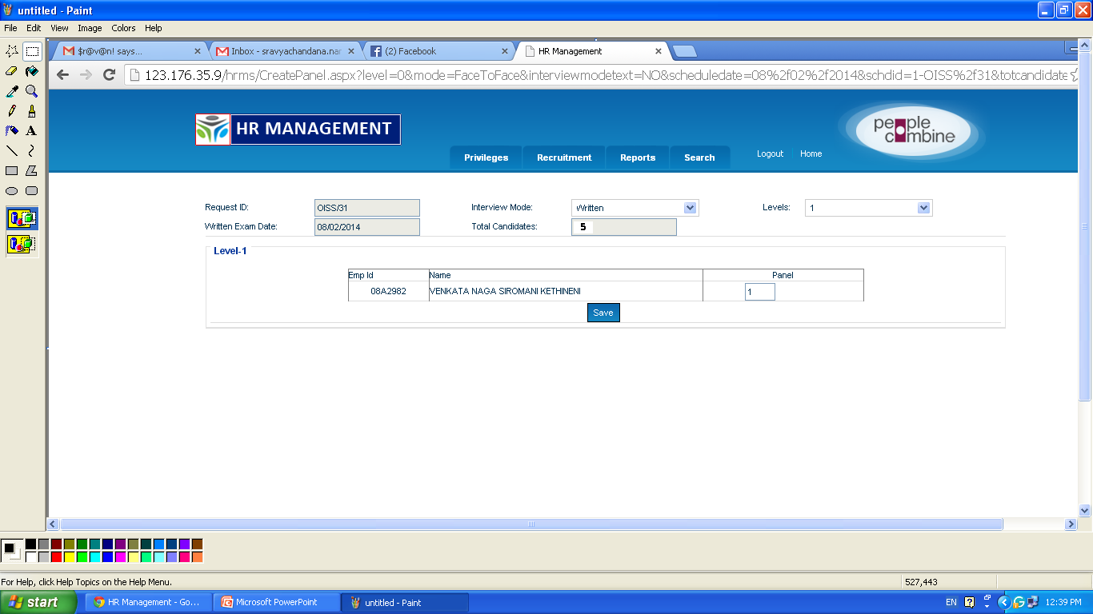
Enter Panel number and click on “save”

Slide 48
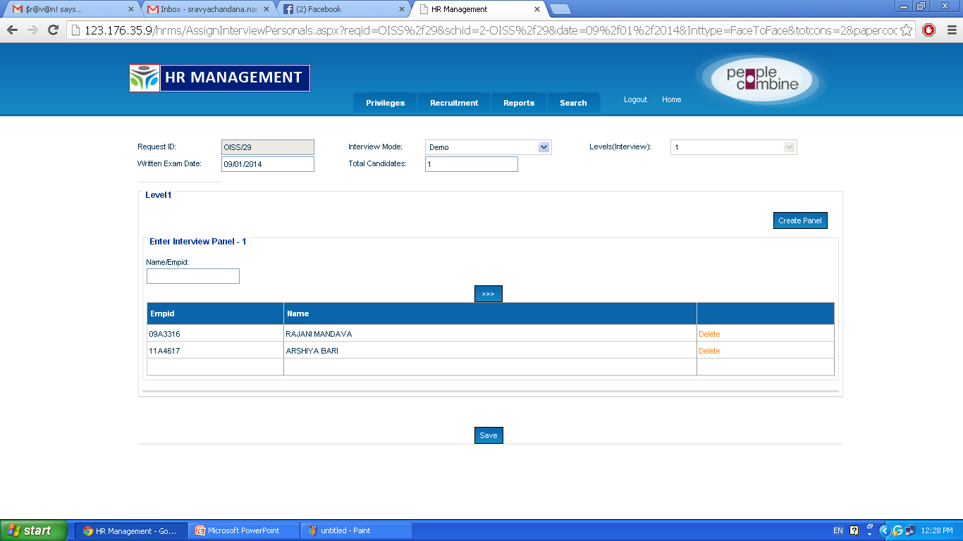
Same process is assigned for Demo and interview

Slide 49
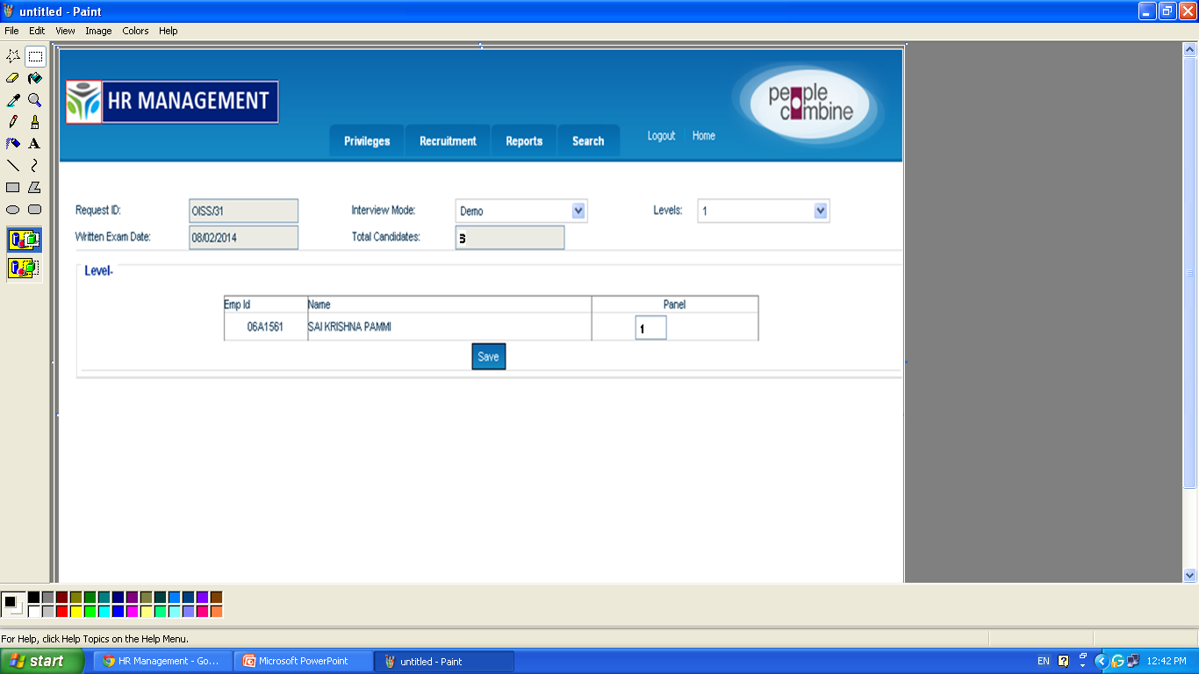
Enter Panel number and click on “save” button
After Written test Assessment, Demo panel is allotted for selected candidates in only Written test

Slide 50
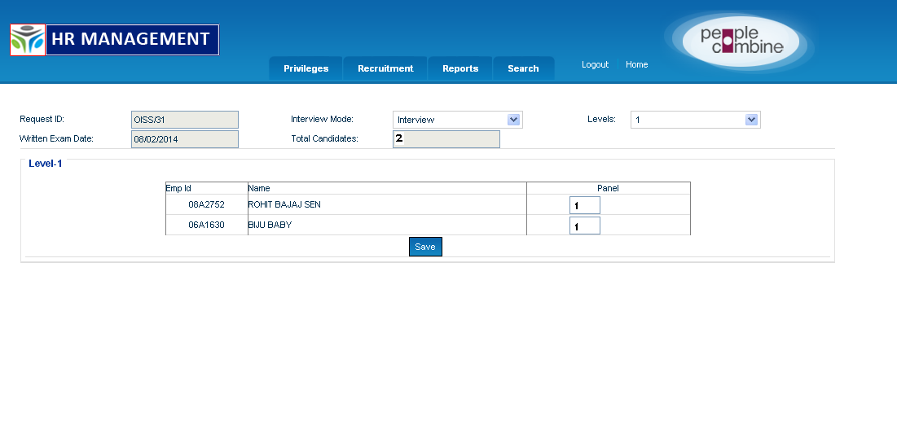
Enter Panel number and click on “save” button
After Demo Assessment, Interview panel is allotted for selected candidates in only Demo

Slide 51
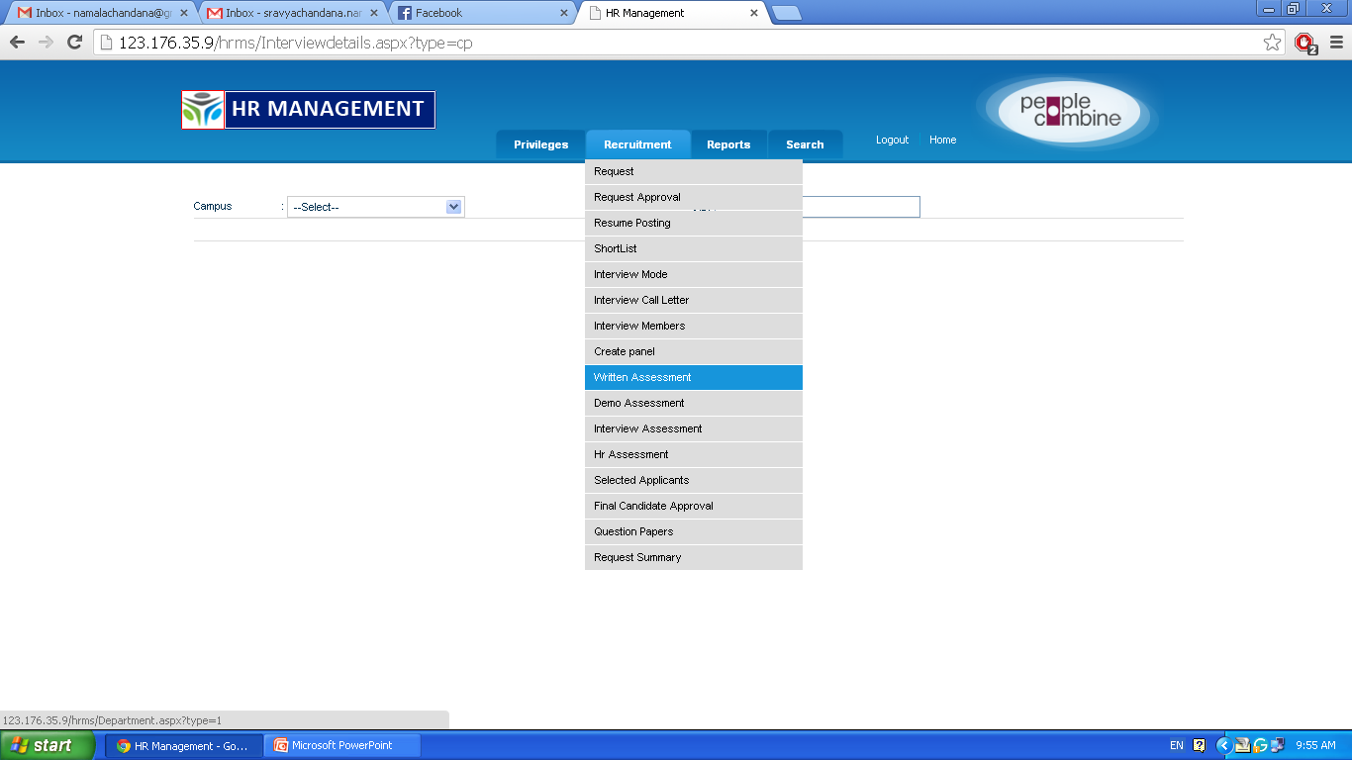
Click on “Written Assessment” for particular Panel member
Notes:
The written Assessment will be done by the assigned panel

Slide 52
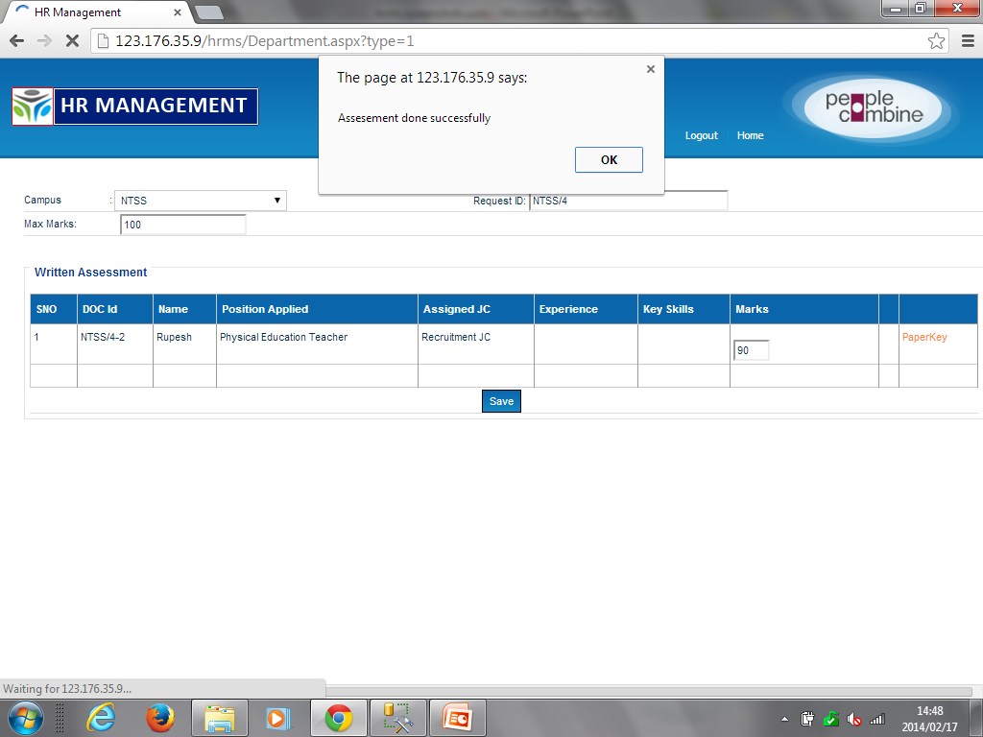
After selecting the Campus , request id and entering the marks click on “save” button
Notes:
After clicking on “save”. A window is displayed showing “Assessment is done successfully”

Slide 53
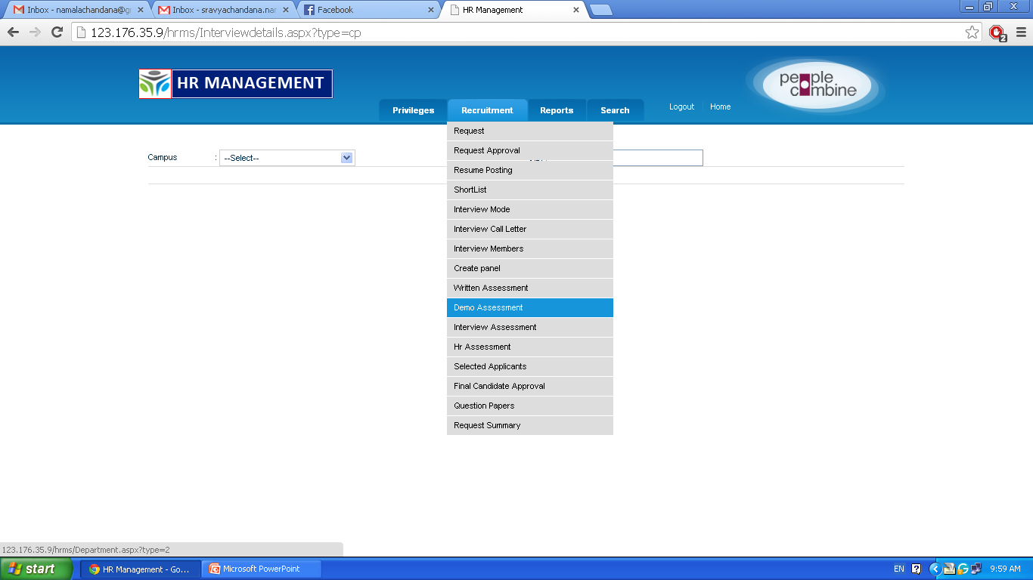
Select the “Demo Assessment”

Slide 54
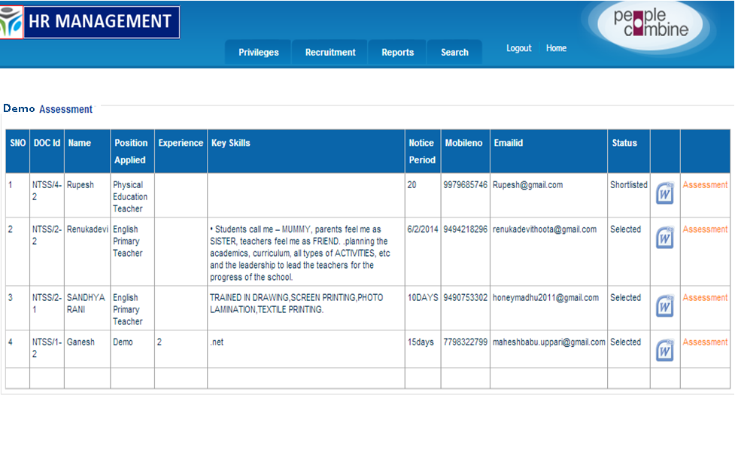
Click on “Assessment” for particular panel member.

Slide 55
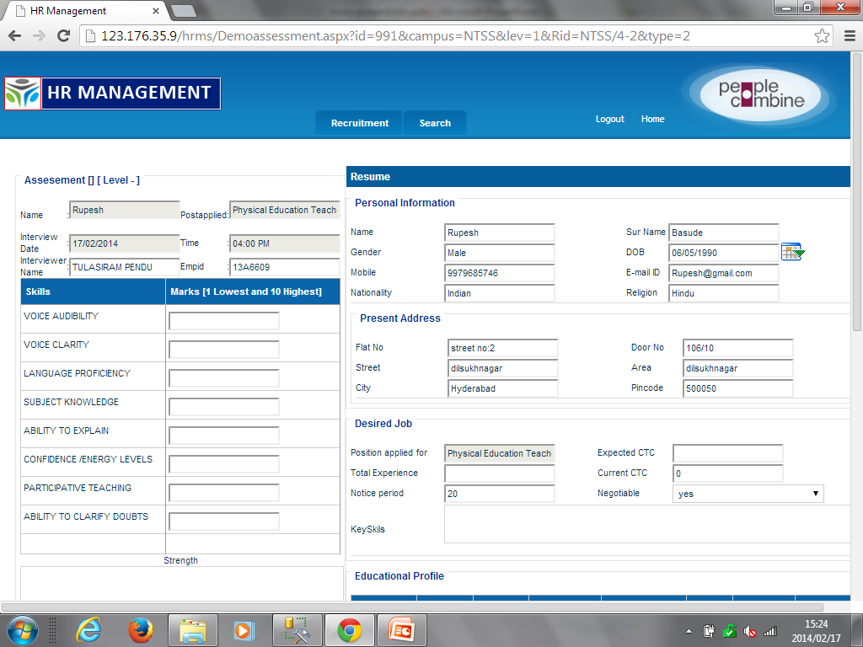
Enter the Demo marks into textboxes
Enter the Strength and weakness and click on save

Slide 56
Select the “Interview Assessment”

Slide 57
Click on “Assessment” for particular panel member.

Slide 58
Enter the interview marks into textboxes
Enter the Strength and weakness and click on save

Slide 59
Select the “HR Assessment”
Notes:
The HR Assessment will be done by panel HR

Slide 60
Click on “Assessment”. This is done by HR

Slide 62
Select “Result” and click on “save”:

Slide 64
Click on this
Notes:
After completion of “HR Assessment” then select “Selected Applicants”

Slide 65
1. Select the Campus and Request ID
2. Enter Joining date and save
3. Click on “Save”
4. Click on “Sal Matrix”

Slide 66
1. Enter the details and click on “submit”
2. Click on “Show” button
Notes:
If Grade JC is not displayed by default. It should be entered manually

Slide 67
Only Head of the campus can use “Final Candidate Approval”

Slide 68
Click on “Approve”
Enter the Approved/ Rejected Comments

Slide 69
1. Attach offer letter
2. Send offer letter

Slide 70
“Employee Login ID“: Temporary login id be fore joining
Please check and click here to send the offer letter

Slide 71
To check the status of particular Resume click “Candidate Status”

Slide 72
Select Campus and Request ID
Status of the candidate is displayed

Slide 73
Temporary employee Login ID for accepted terms & conditions

Slide 74
Click on “Next”

Slide 75
1. Enter the joining date and select the Terms & Conditions
Once you click on finish Employee ID will be generated

Slide 76
THANK YOU

